Slide 1
2 tam giac dong dang (truong hop 1)

Slide 2
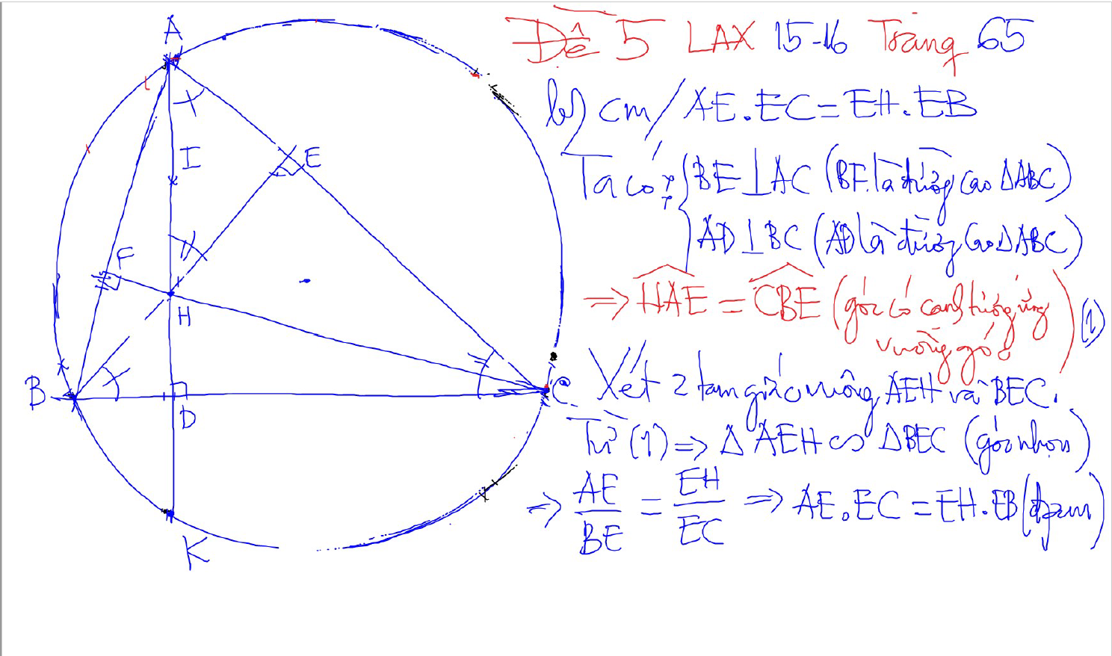
2 tam giac dong dang (truong hop 1)
2 goc bang nhau
1 goc nhon bang nhau

Slide 3
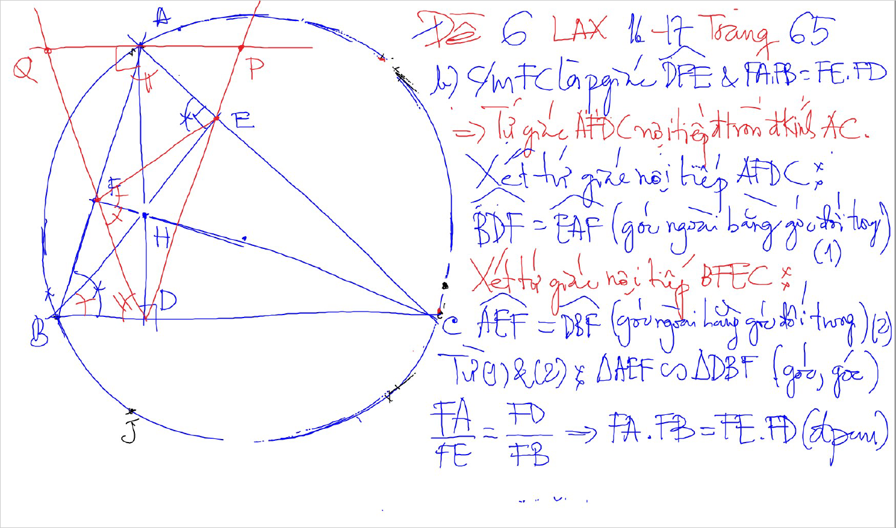
2 tam giac dong dang (truong hop 1)
2 goc bang nhau
1 goc nhon bang nhau

Slide 4
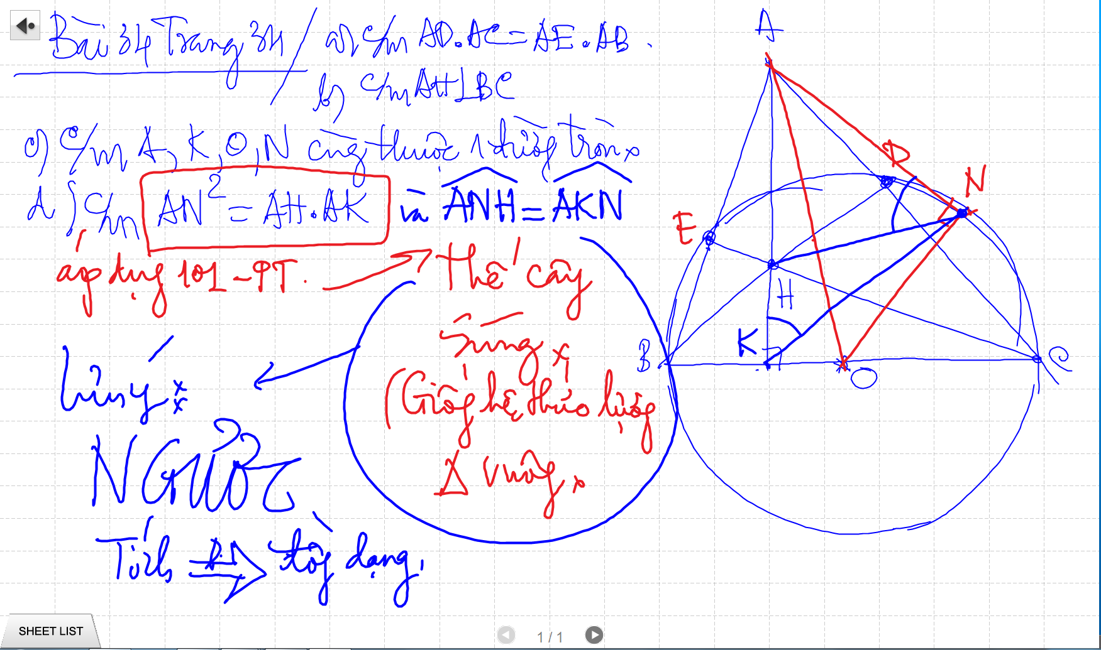

Slide 5
Bai 53 De Cuong – Euler

Slide 6
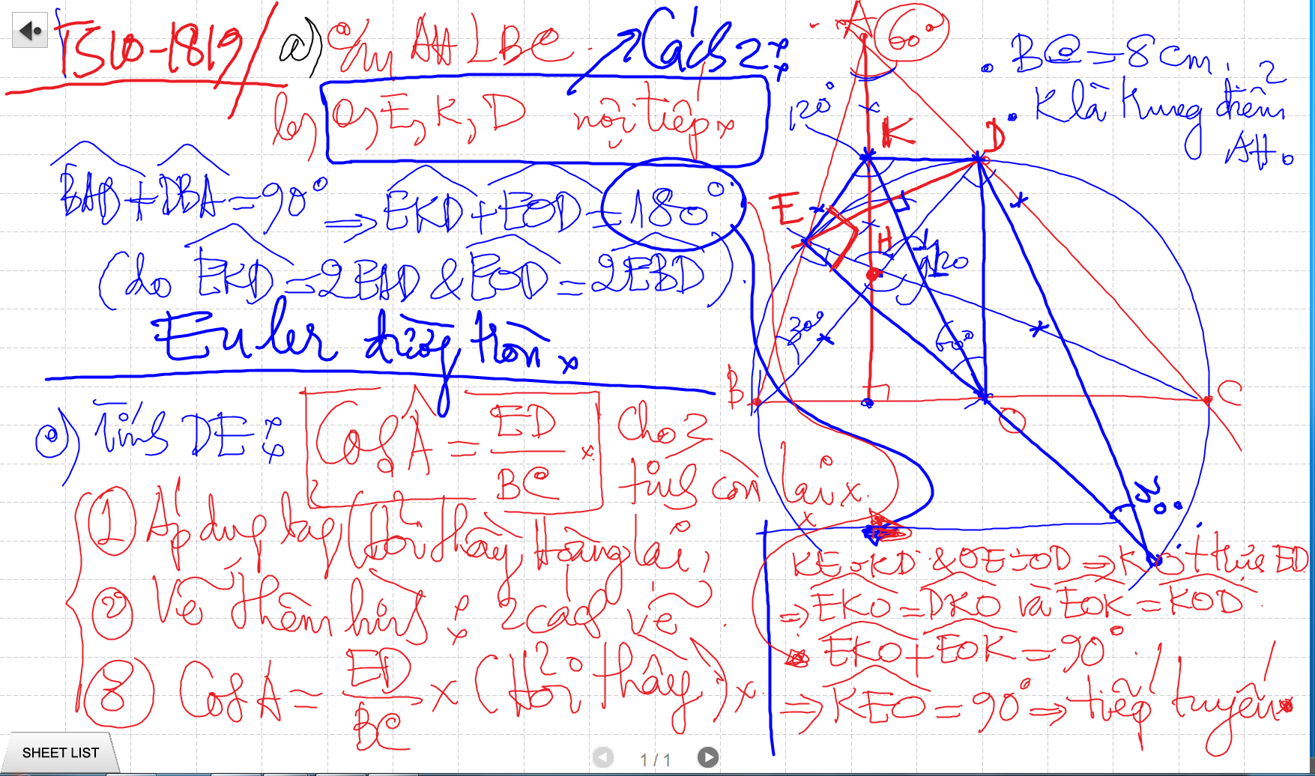
Bai 53 De Cuong – Euler

Slide 7
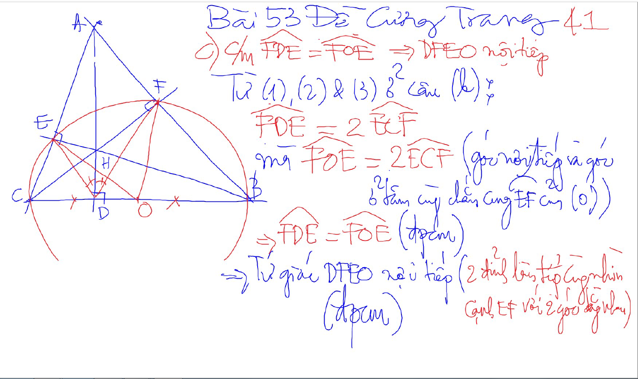
Bai 53 De Cuong – Kinh dien tam giac nhon 1 (xem trong thu muc Tu Giac Noi Tiep)

Slide 8
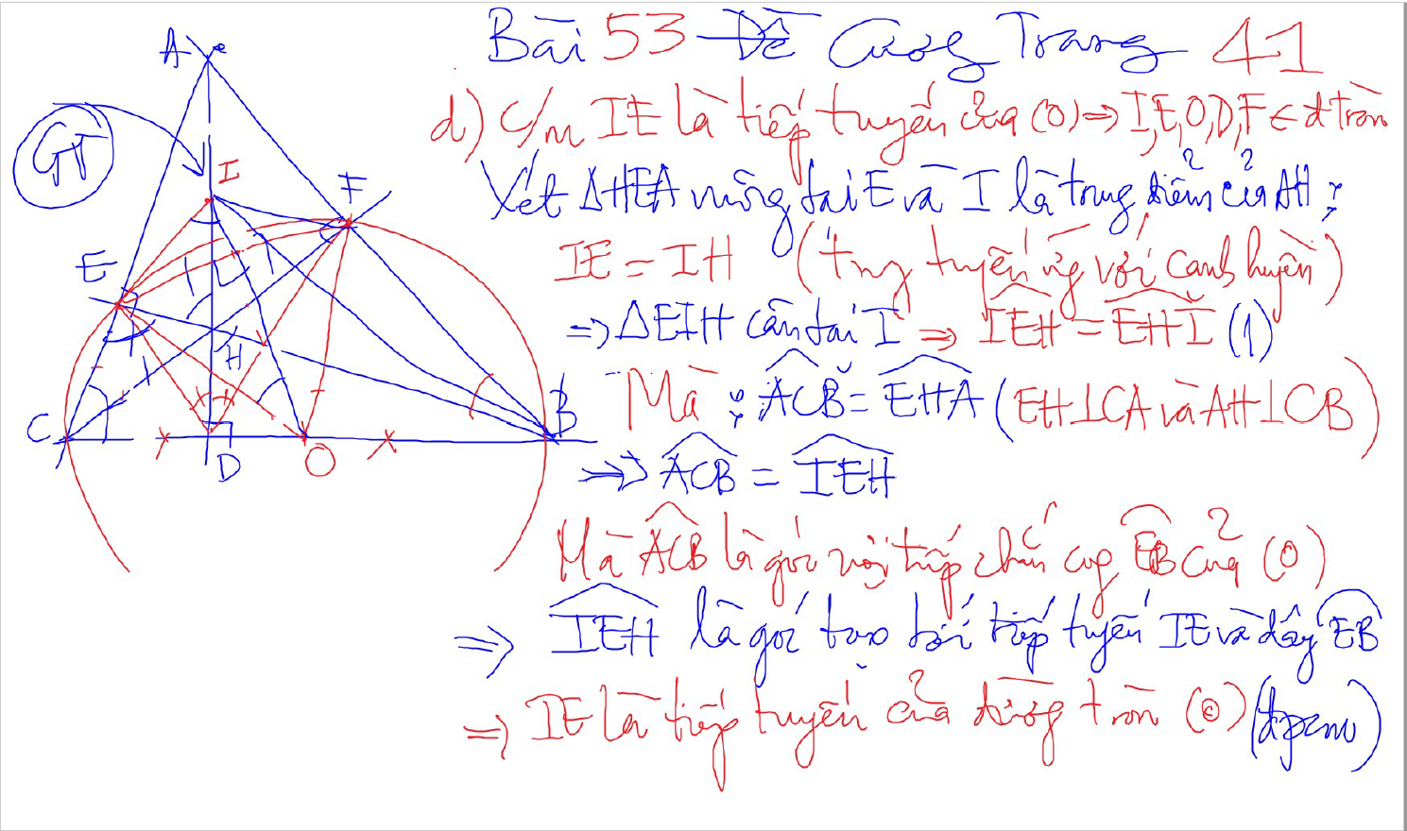
Bai 53 De Cuong – Kinh dien tam giac nhon 1 (xem trong thu muc Tu Giac Noi Tiep)

Slide 9
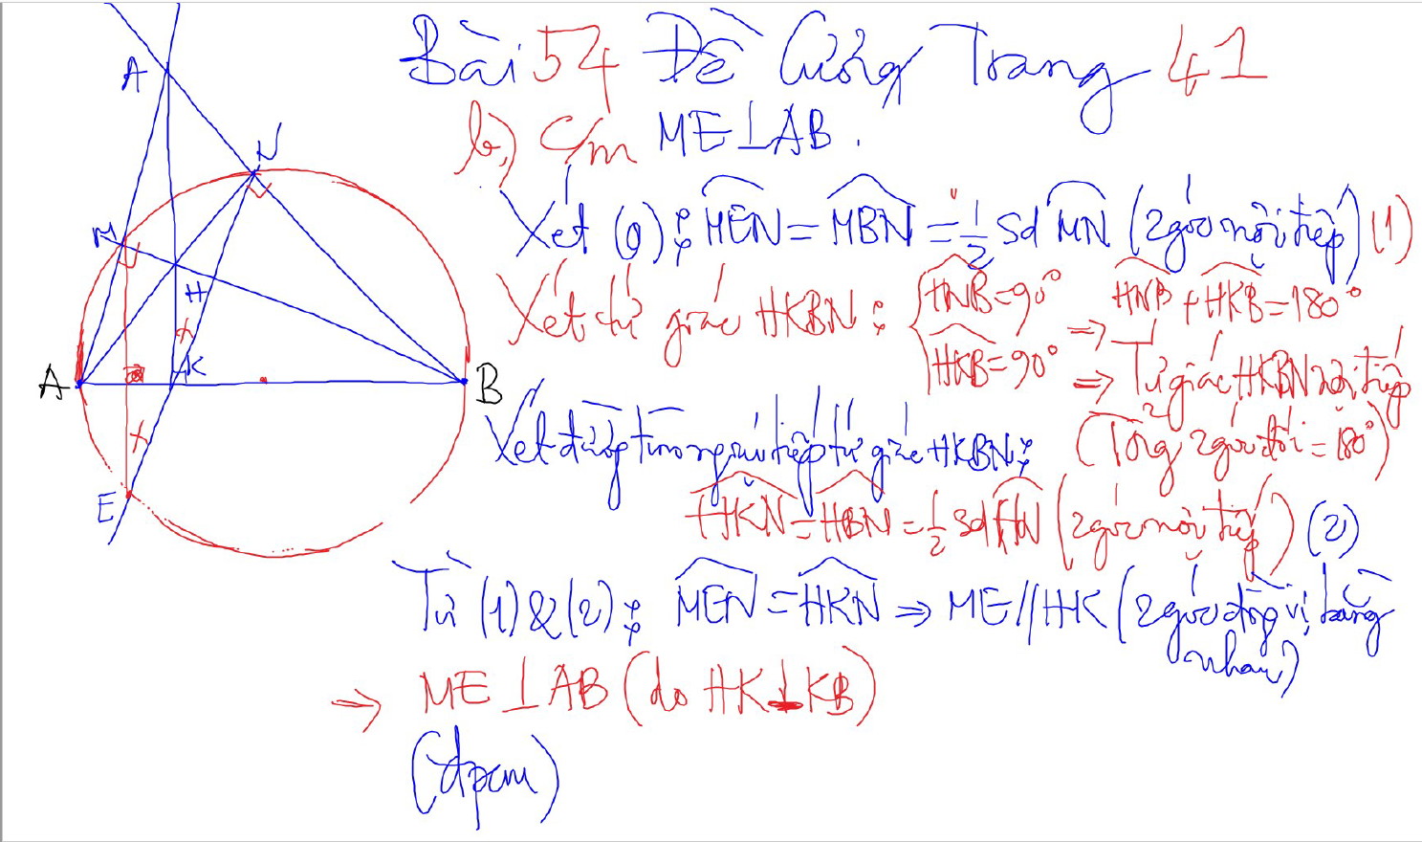
Bai 54 De Cuong – Kinh dien tam giac nhon 1 (xem trong thu muc Tu Giac Noi Tiep)

Slide 10
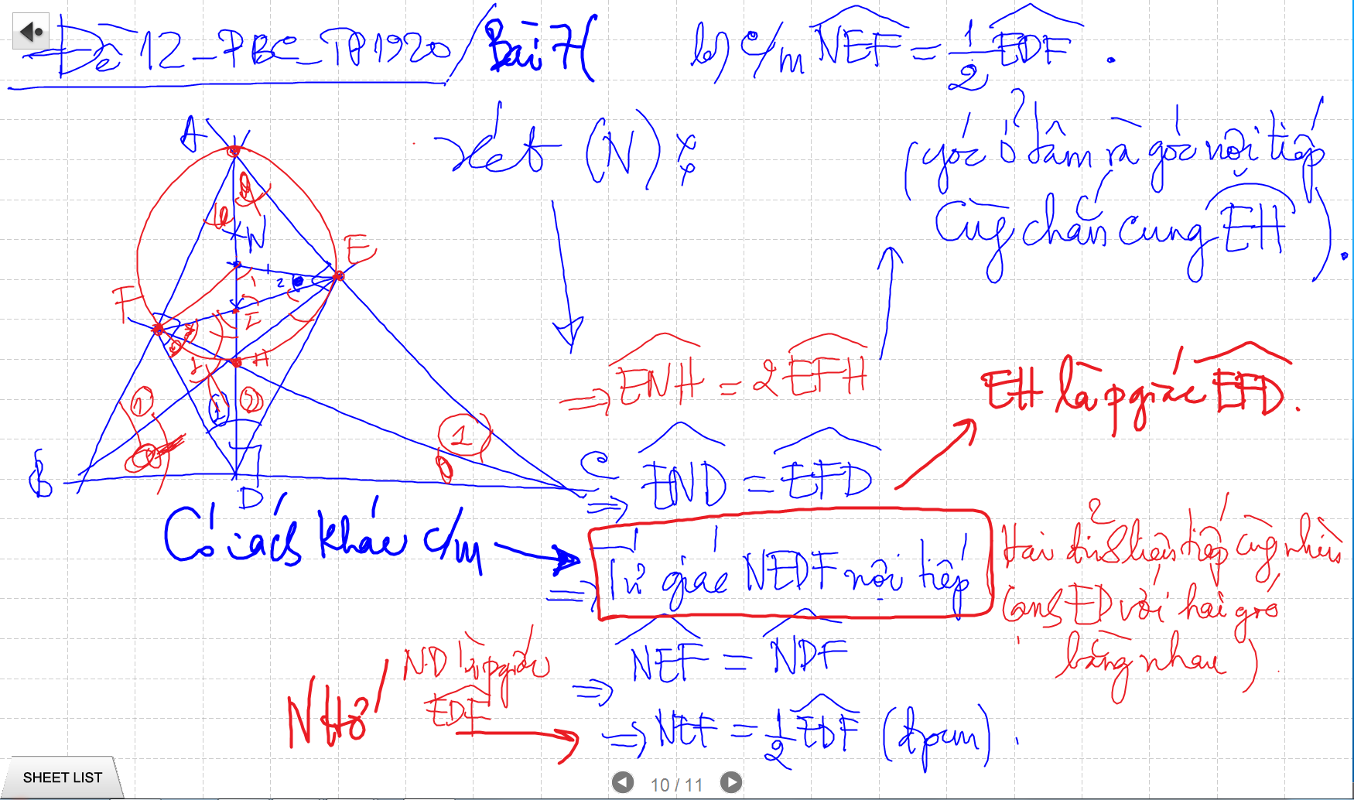
CM TU GIAC NOI TIEP -> SUY RA CAC GOC BANG NHAU

Slide 11
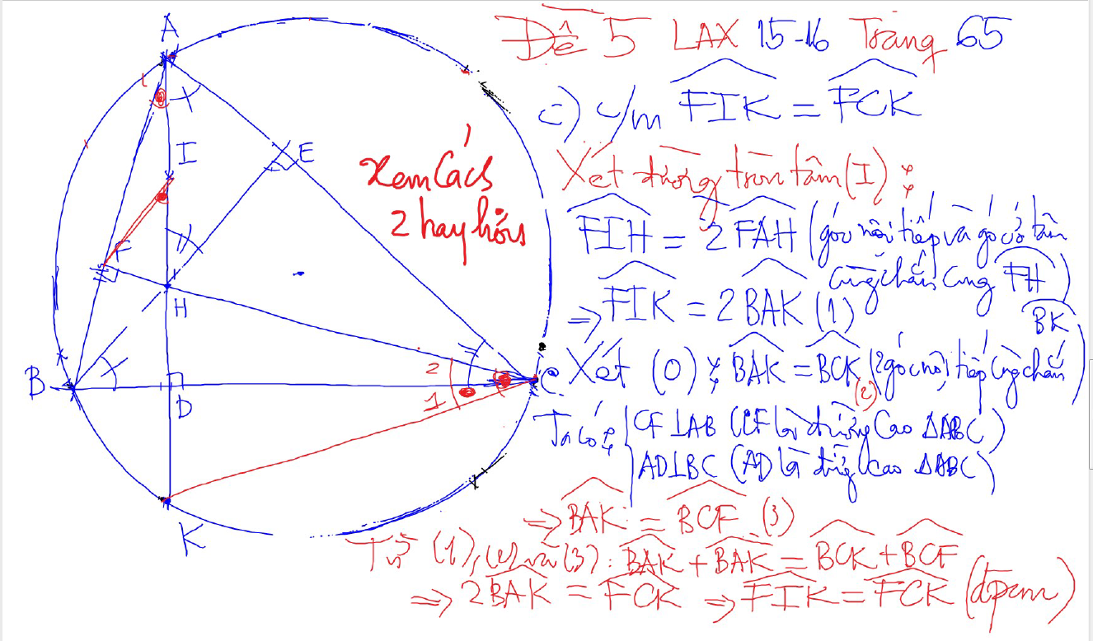
DUONG THANG SIMSON – Ap Dung

Slide 12
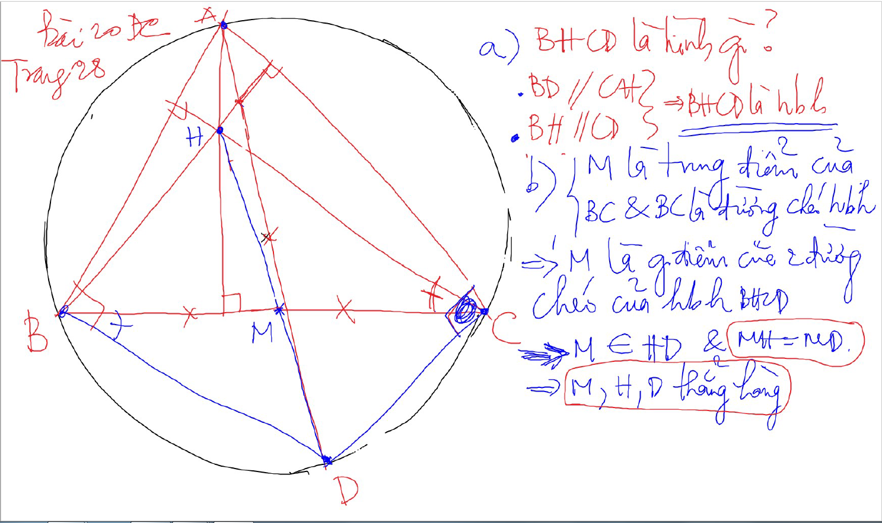

Slide 13
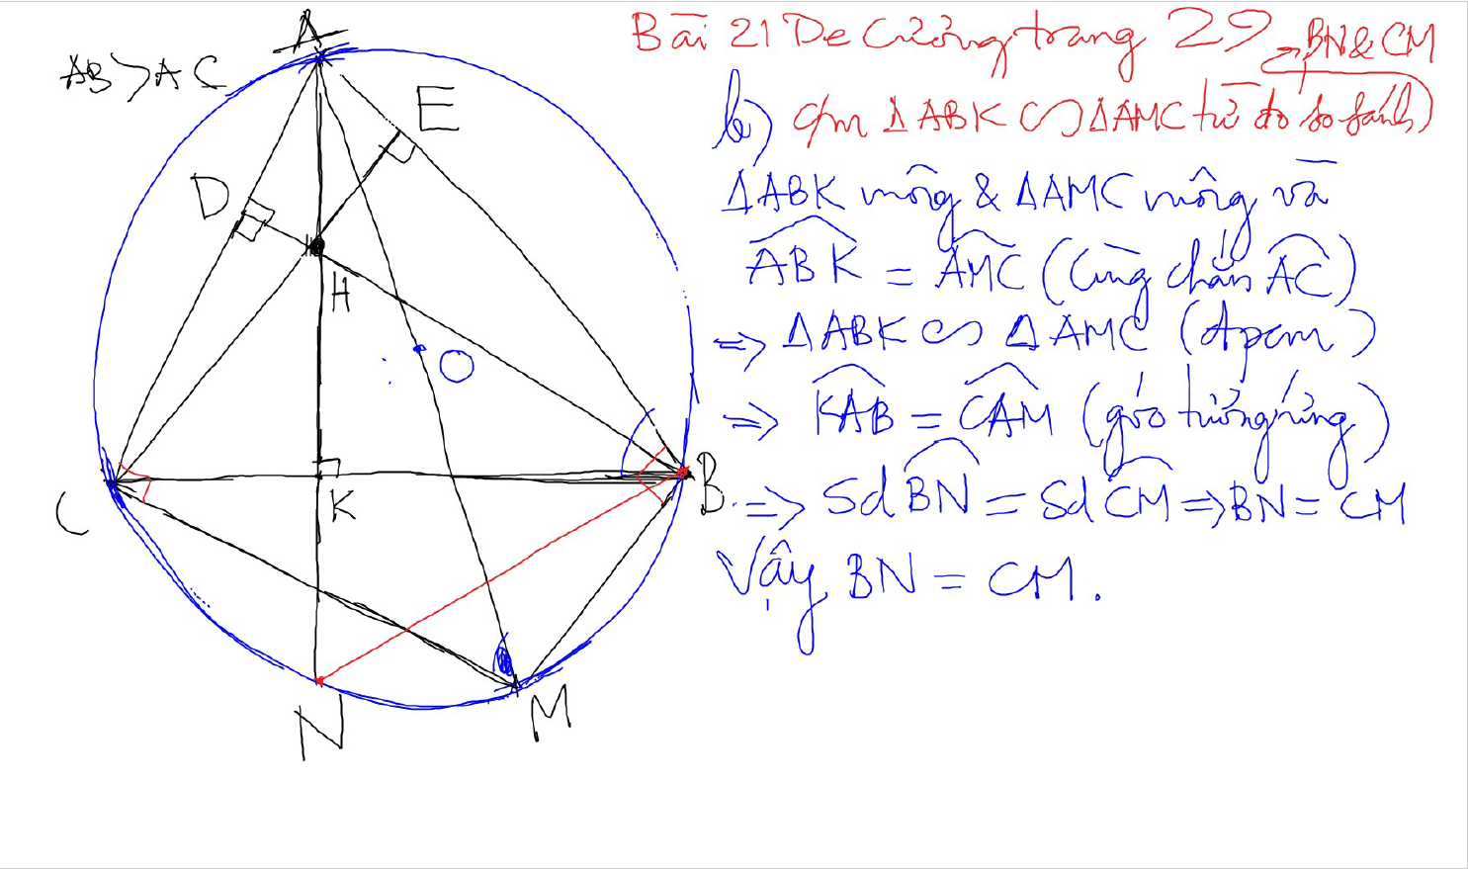

Slide 14
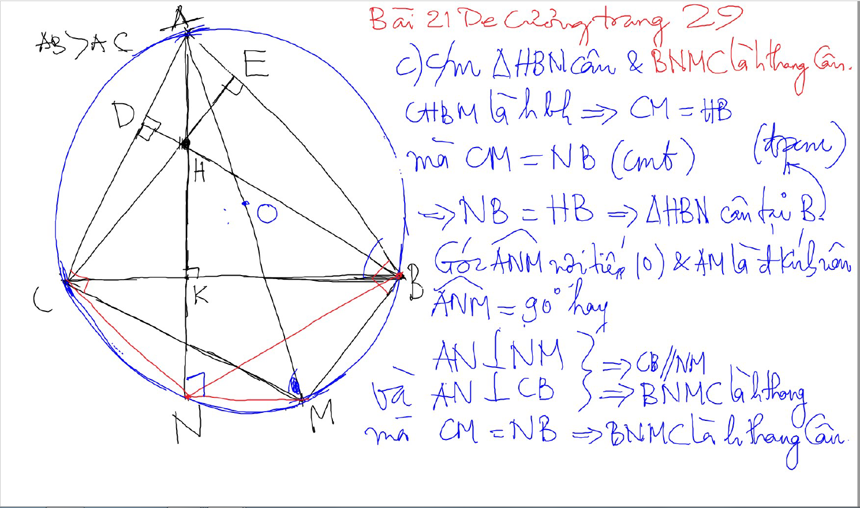

Slide 15
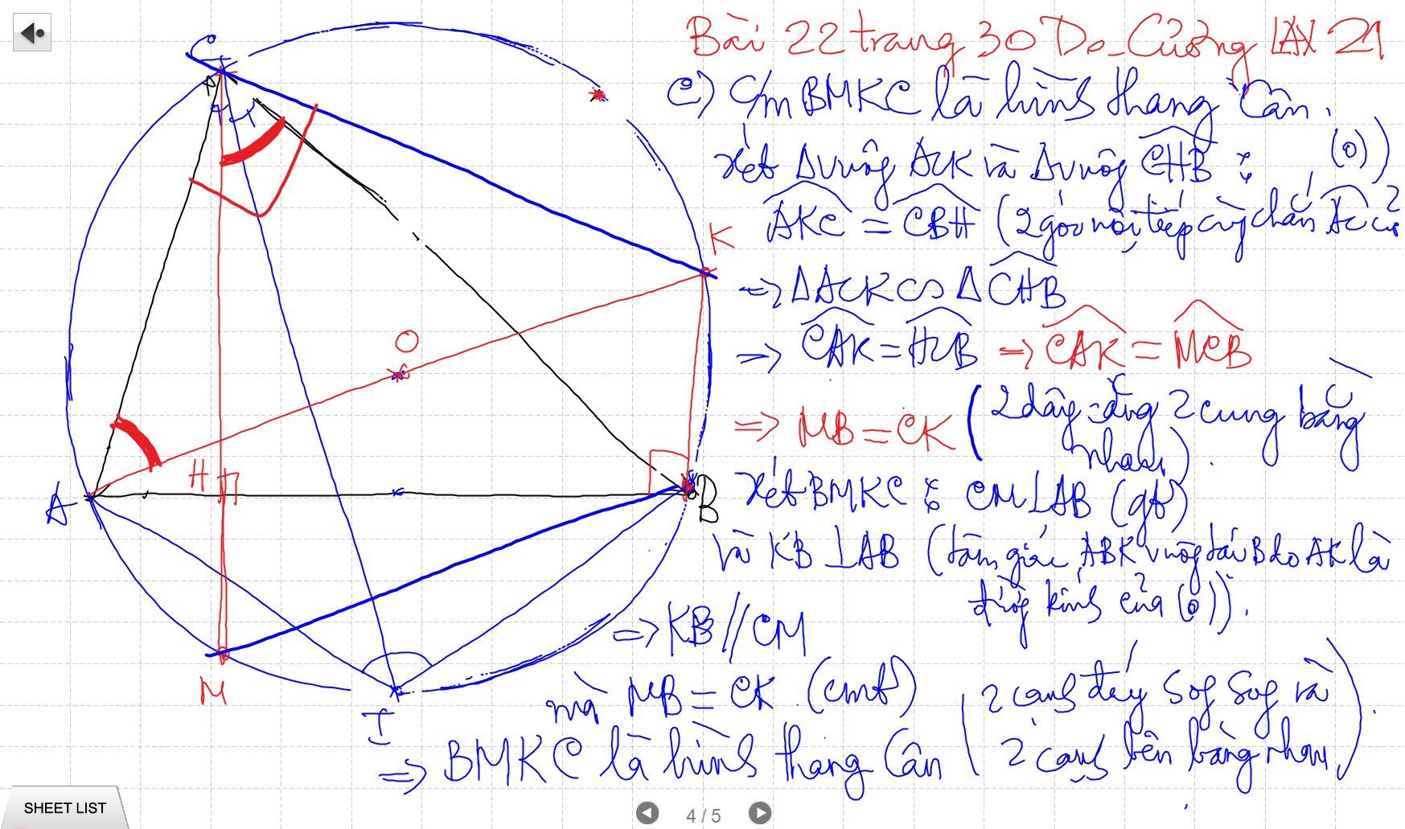

Slide 16
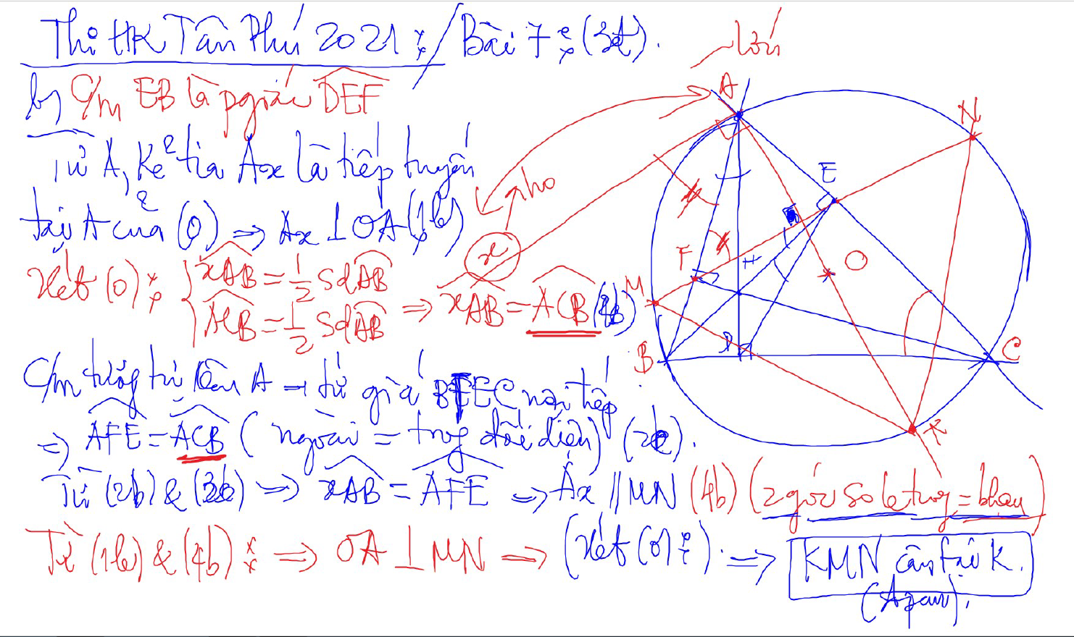
C/m tam giac dong dang truong hop 2

Slide 17
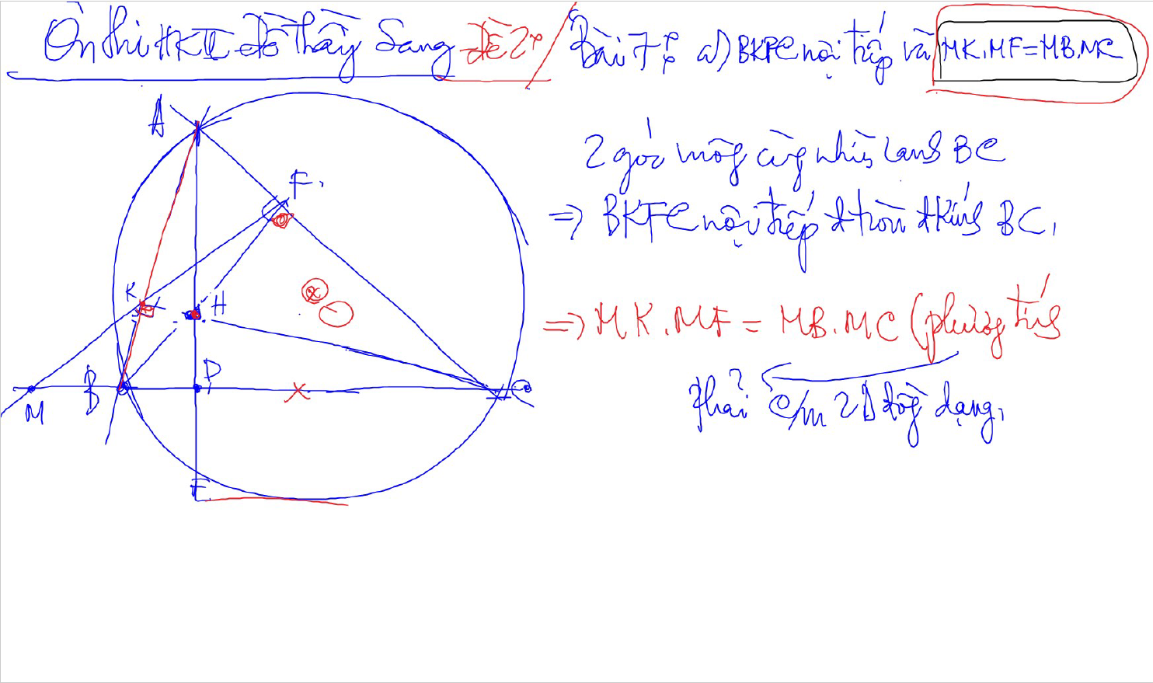
C/m tam giac dong dang truong hop 2

Slide 18
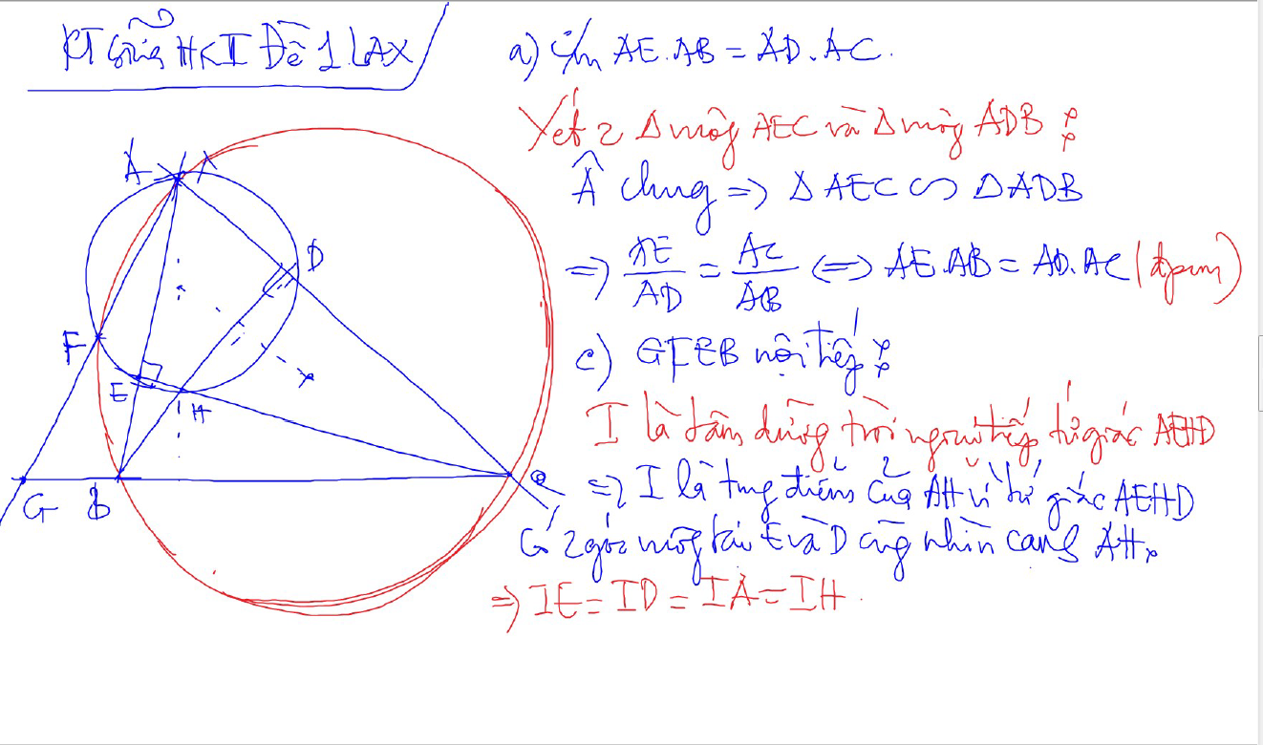

Slide 20
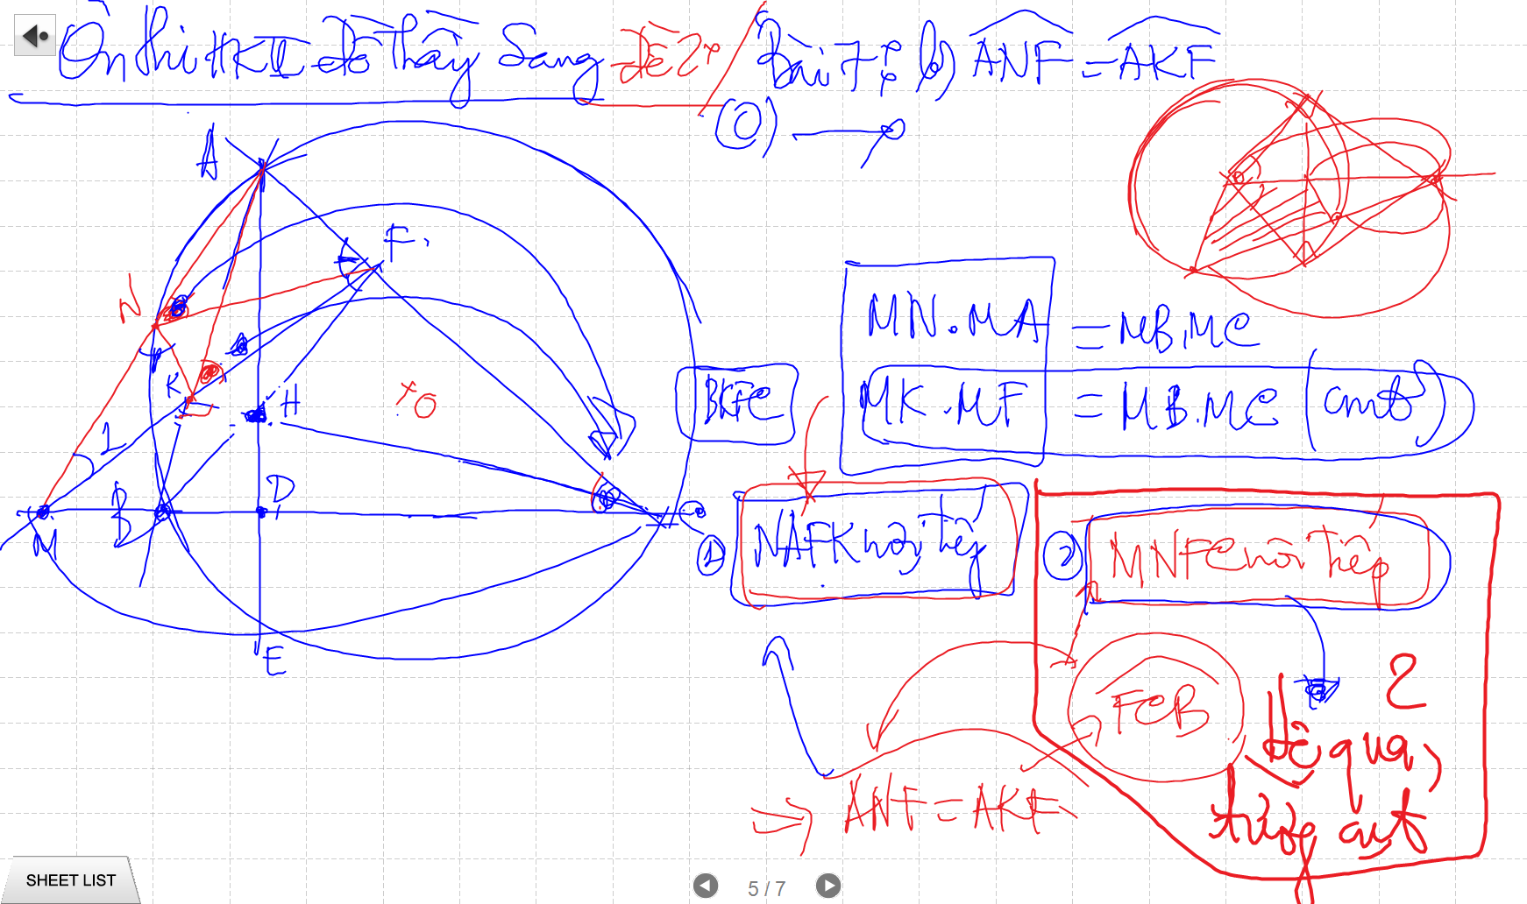
C/m tam giac dong dang truong hop 2

Slide 21
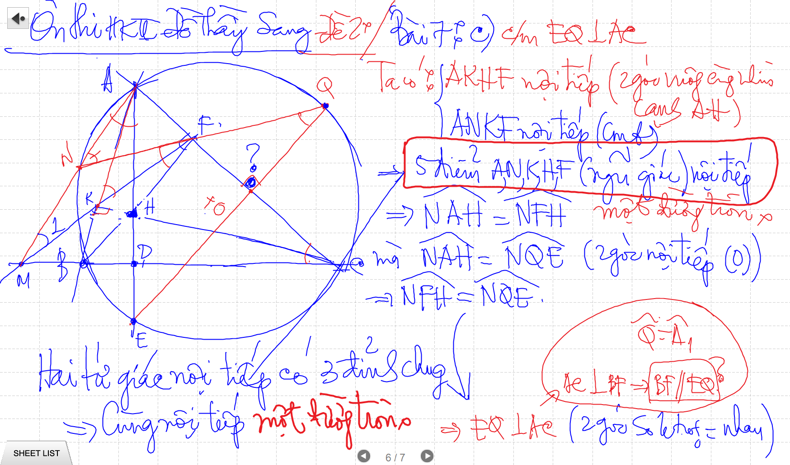

Slide 22
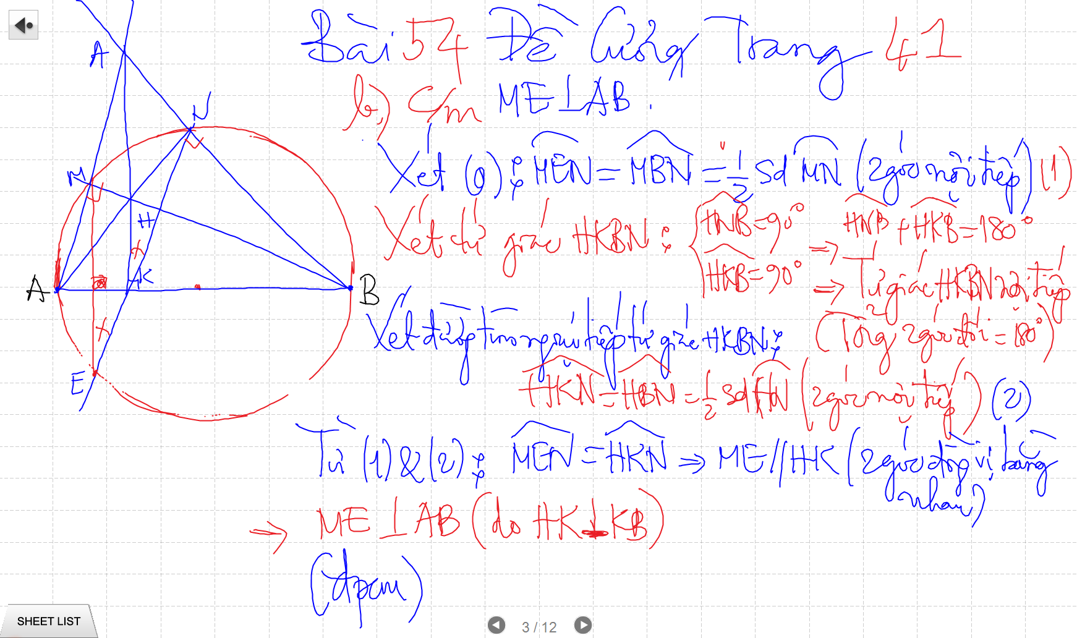

Slide 23
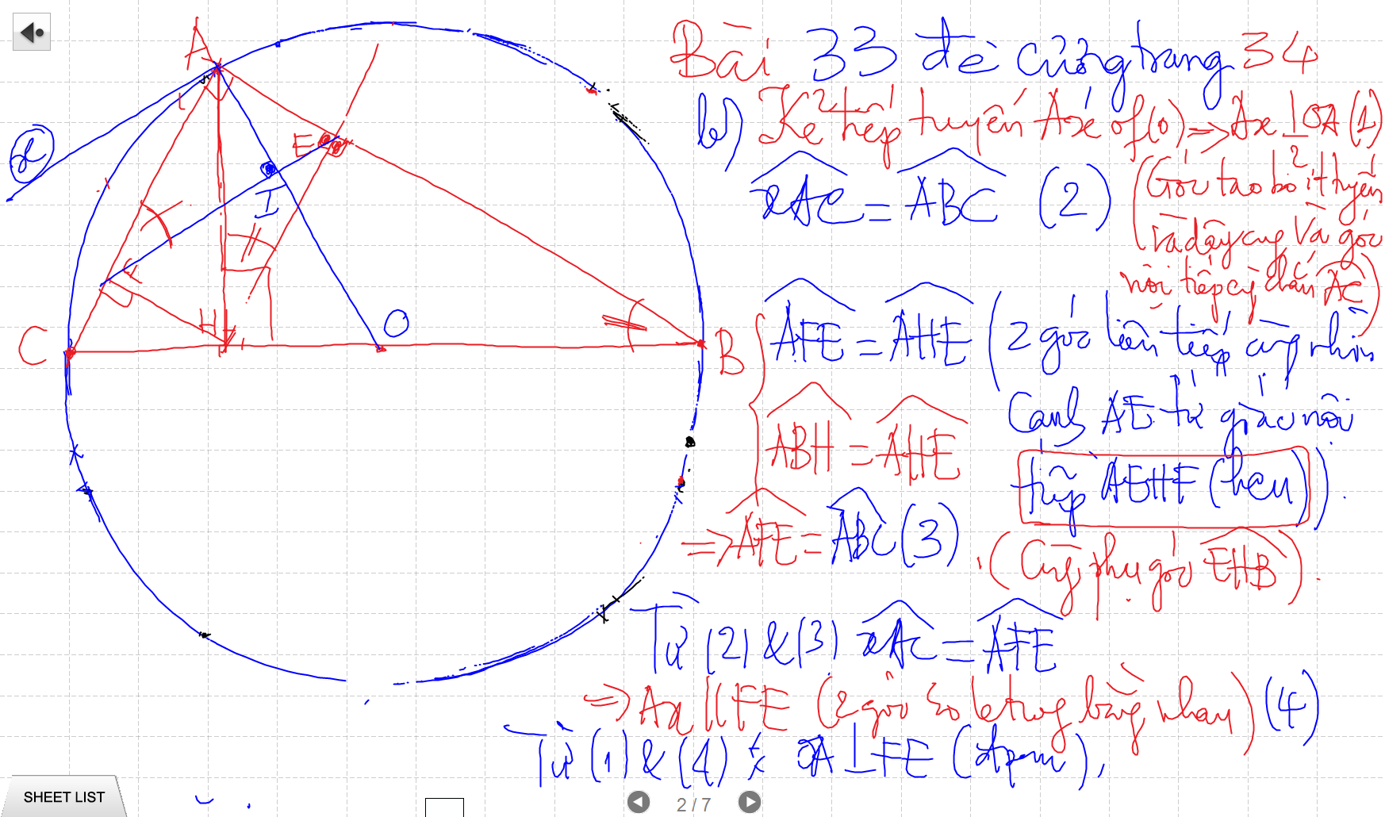
C/m tam giac dong dang truong hop 2

Slide 24
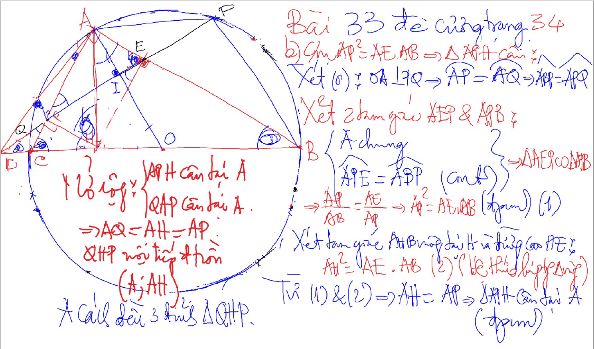
Bai 53 De Cuong – Kinh dien tam giac nhon 1 (xem trong thu muc Tu Giac Noi Tiep)

Slide 25
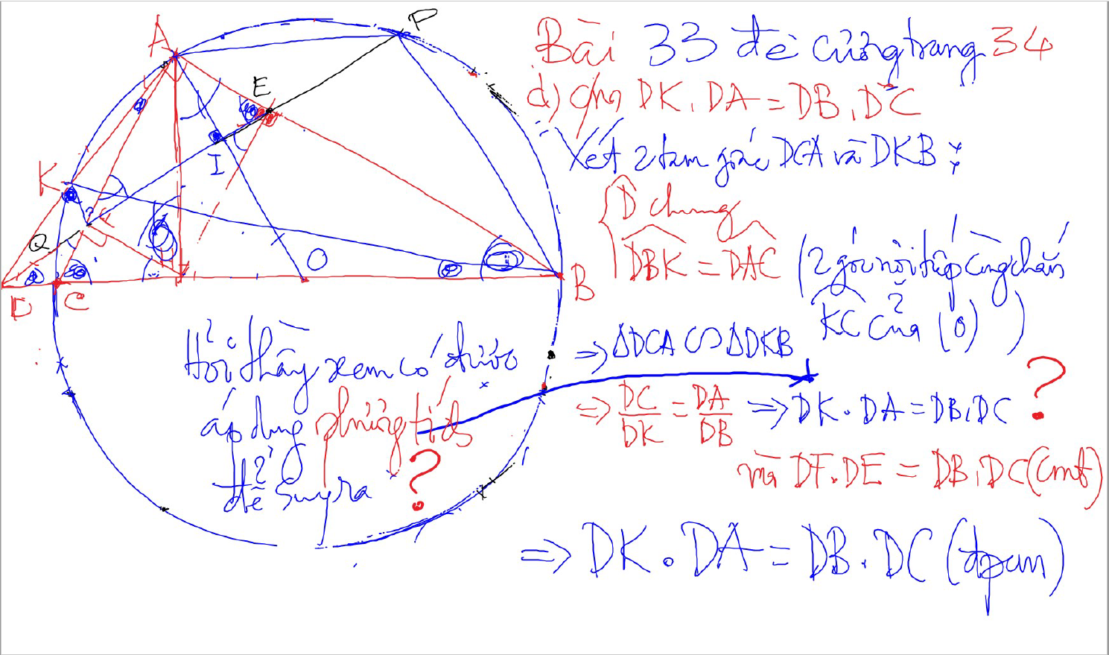
C/m tam giac dong dang truong hop 2

Slide 26
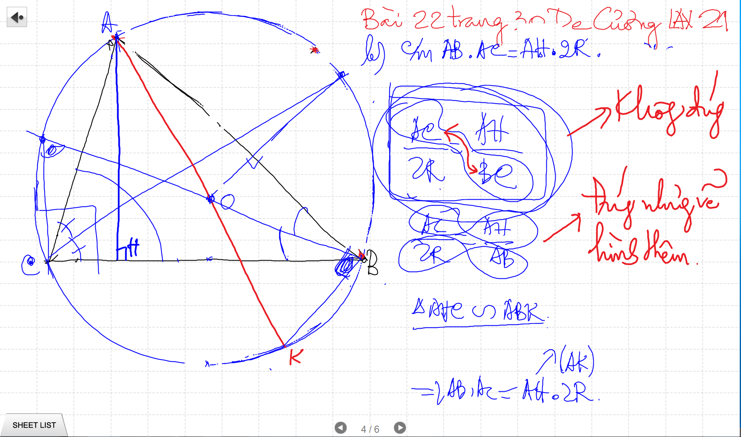

Slide 27
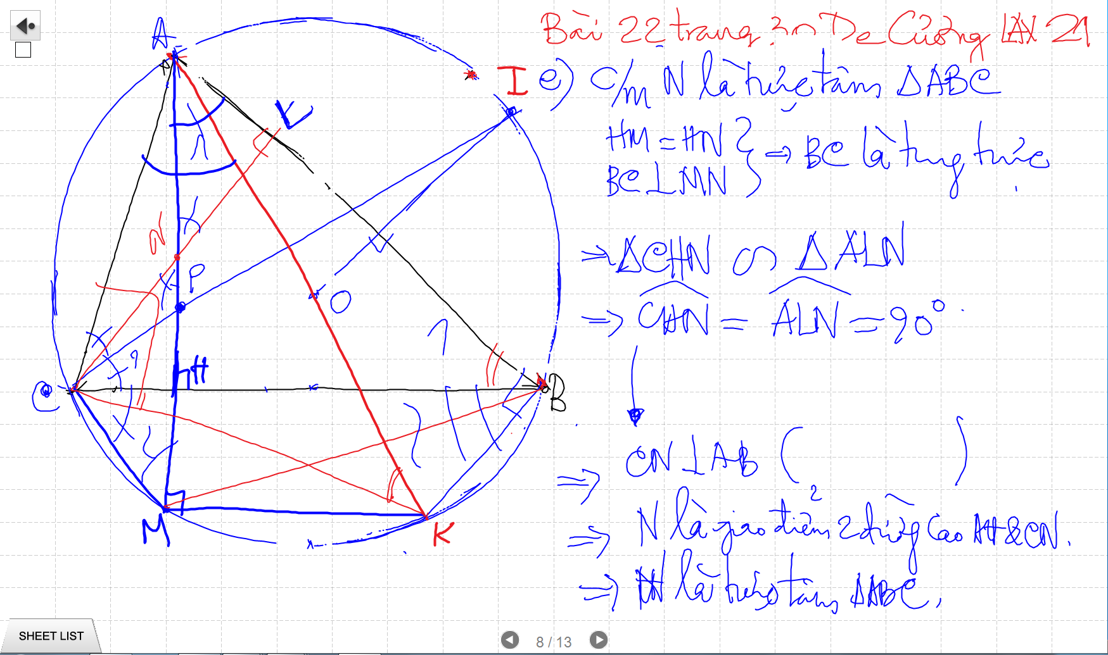

Slide 28
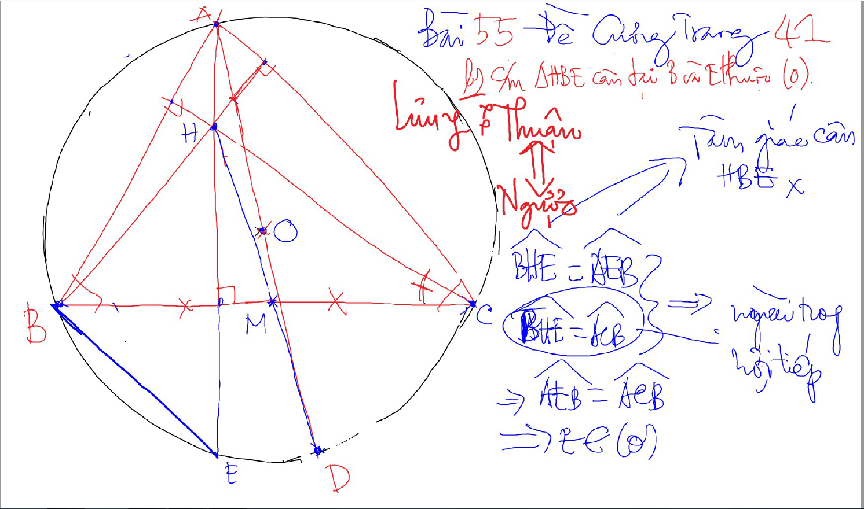

Slide 29
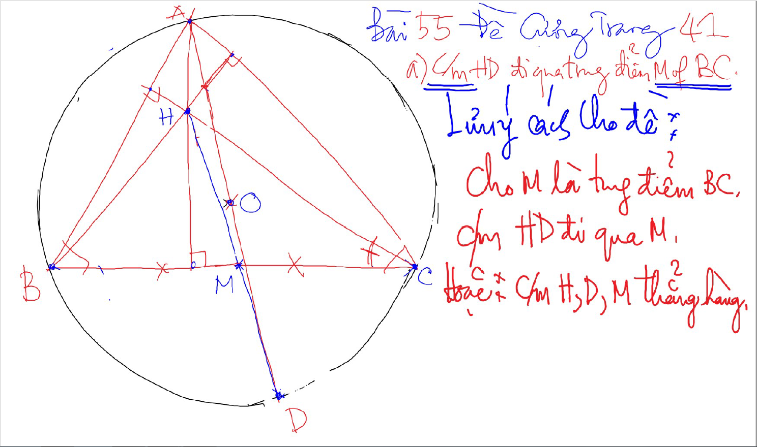

Slide 30
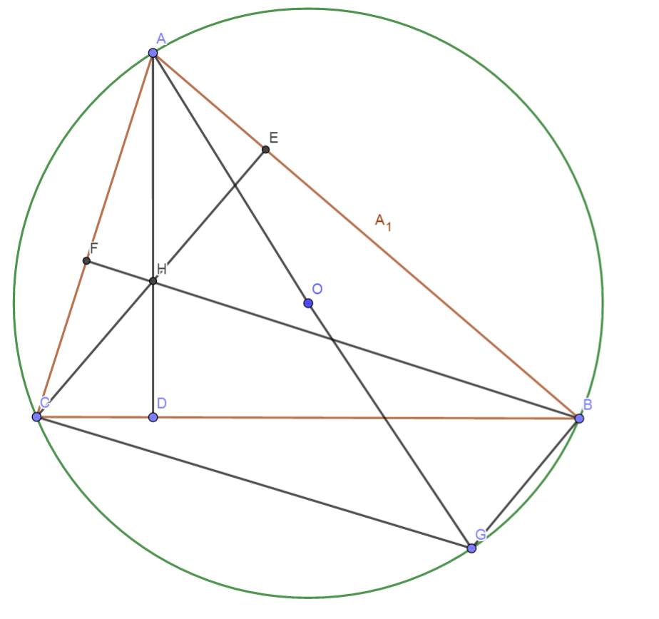
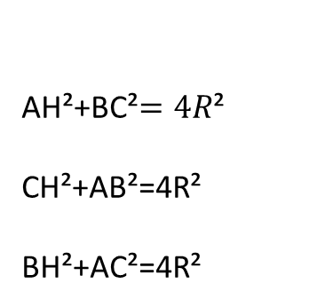
Quan he giua canh day va khoang cach den truc tam
AH²+BC²$=4R$²
CH²+AB²=4R²
BH²+AC²=4R²

Slide 31
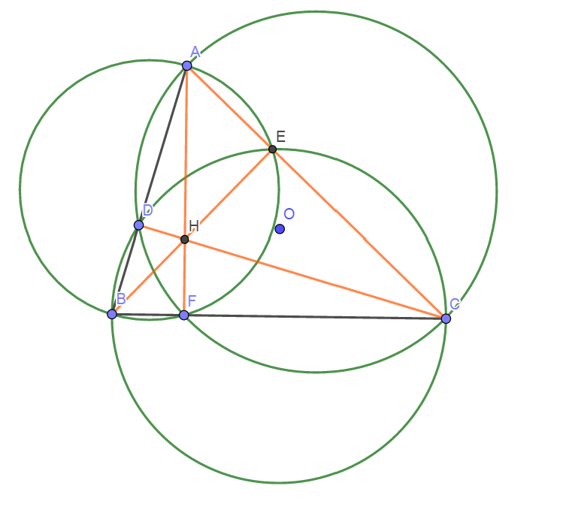
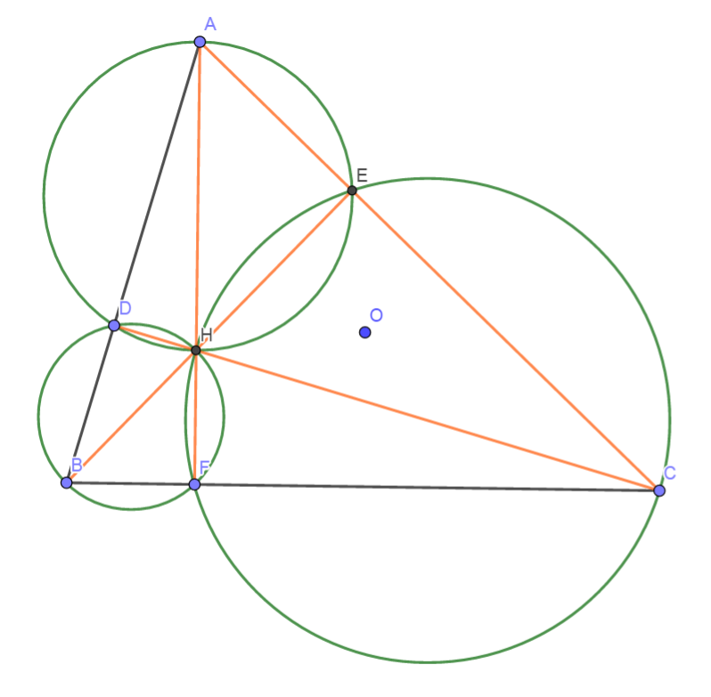
Truc Tam: 6 tu giac noi tiep

Slide 32
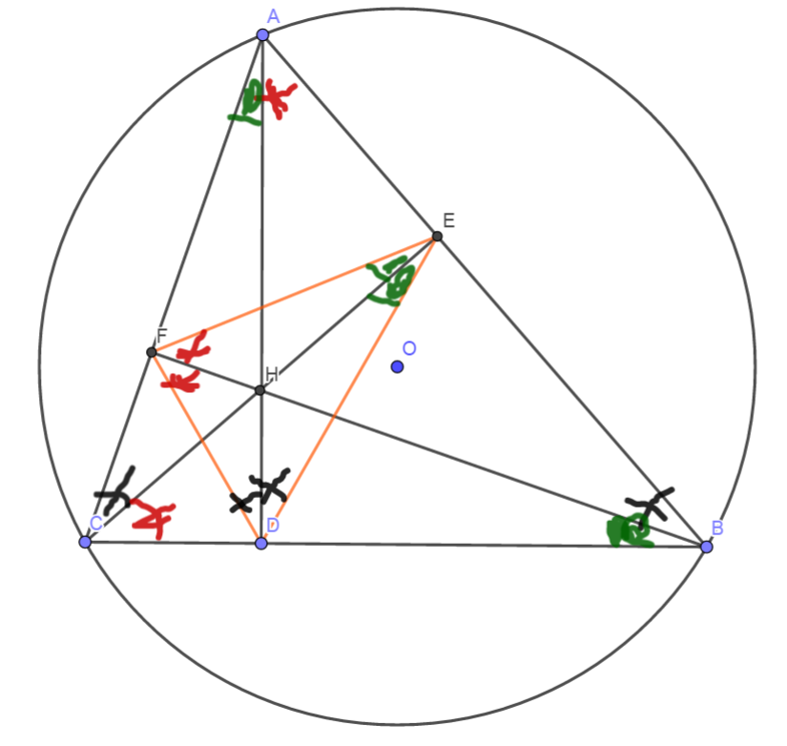
Truc tam: Tinh chat chan 3 duong cao
Chan 3 duong cao tao thanh tam giac DEF
3 duong cao cua tam giac ABC cung la 3 duong phan giac cua tam giac chan duong cao (DEF)
3 tam giac nho o 3 dinh (3 cai banh u) dong dang voi tam giac lon

Slide 33
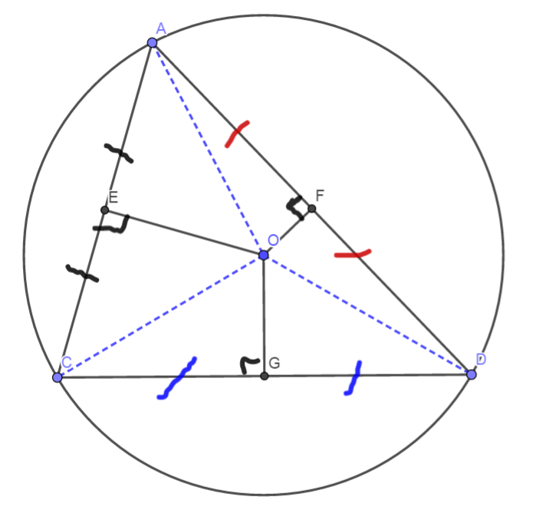
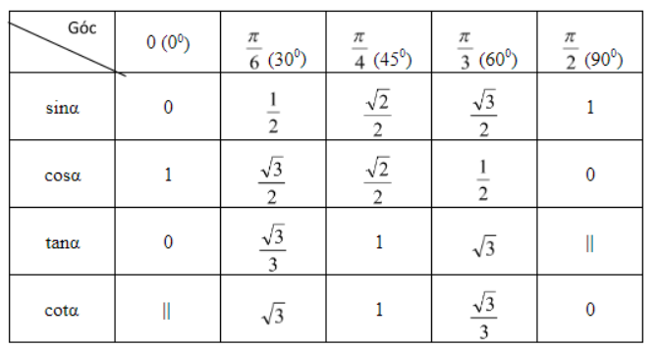
3 duong trung truc dong qui, la tam cua duong tron ngoai tiep tam giac
Giao diem cua 3 duong phan giac la tam duong trong noi tiep tam giac

Slide 34
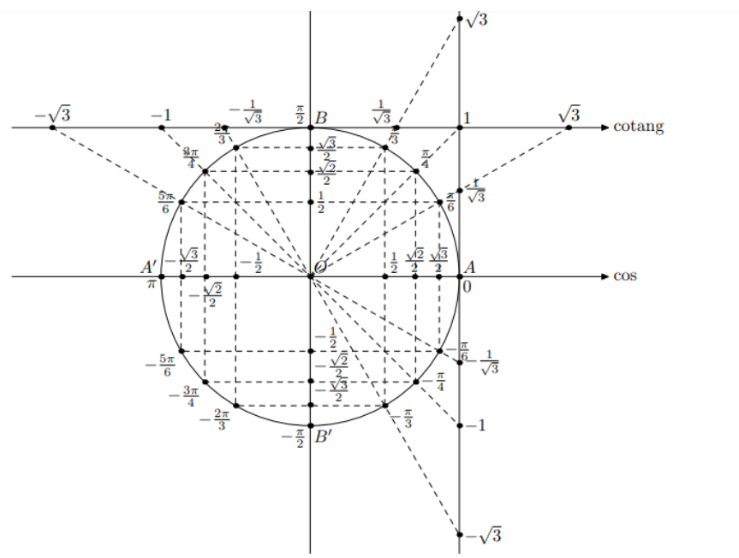

Slide 35
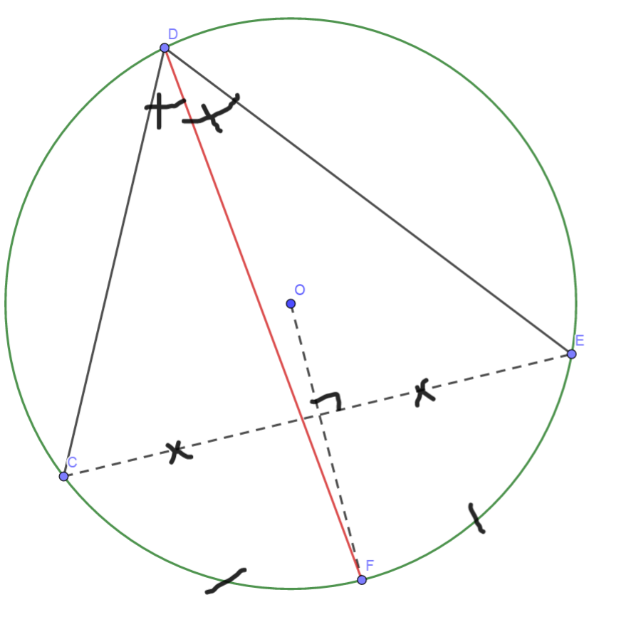
Cach ve duong phan giac cua goc noi tiep

Slide 36
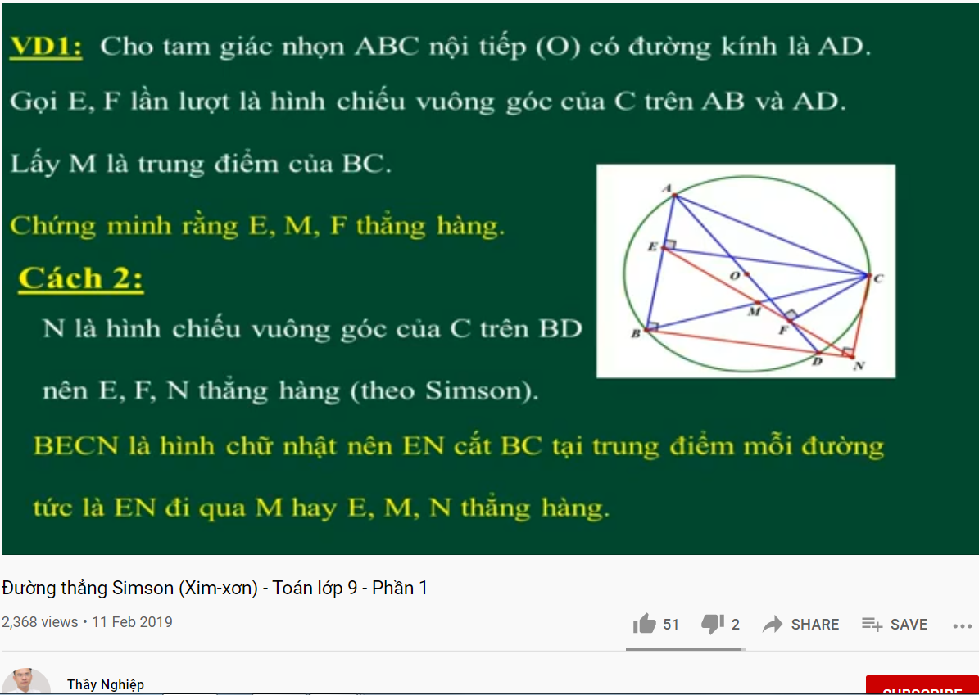
DUONG THANG SIMSON – Ap Dung

Slide 37
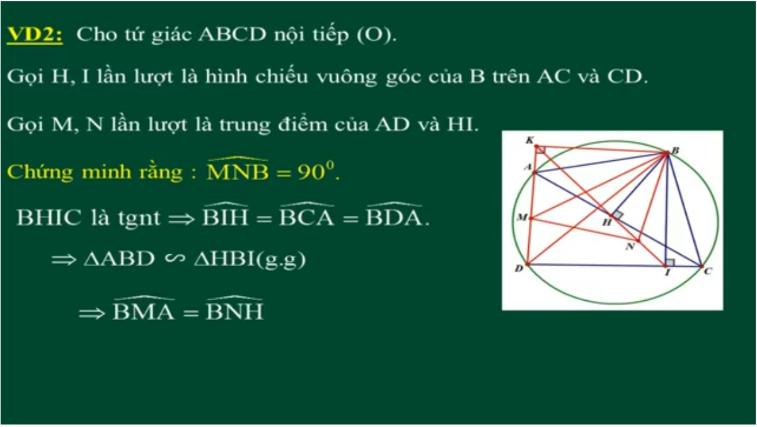
DUONG THANG SIMSON – Ap Dung

Slide 38
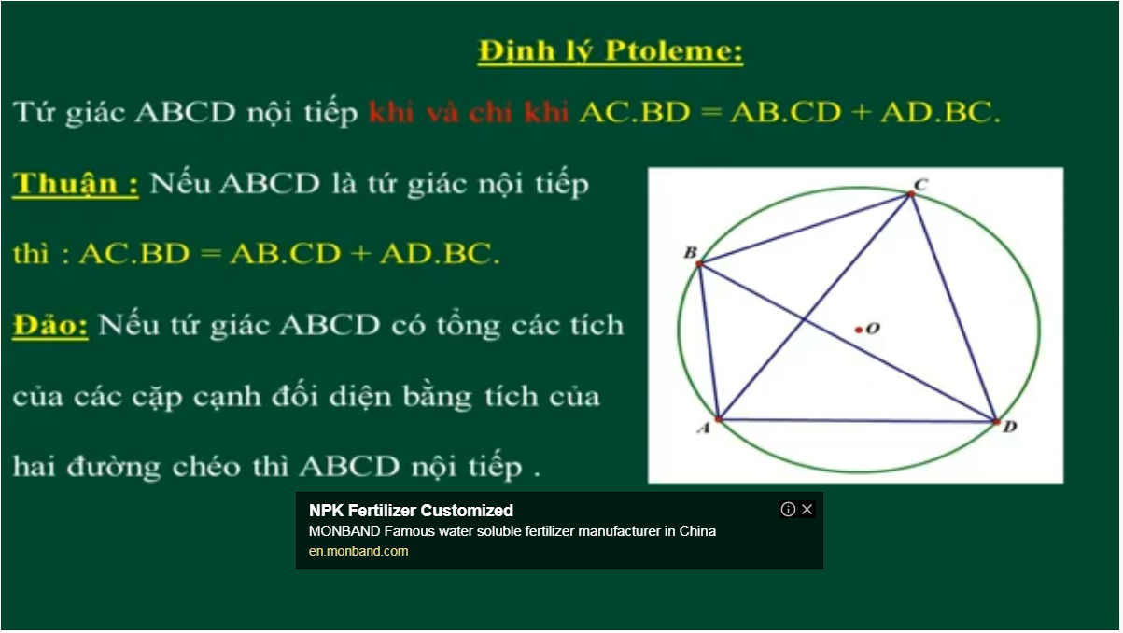
Bai 54 De Cuong – Kinh dien tam giac nhon 1 (xem trong thu muc Tu Giac Noi Tiep)

Slide 39
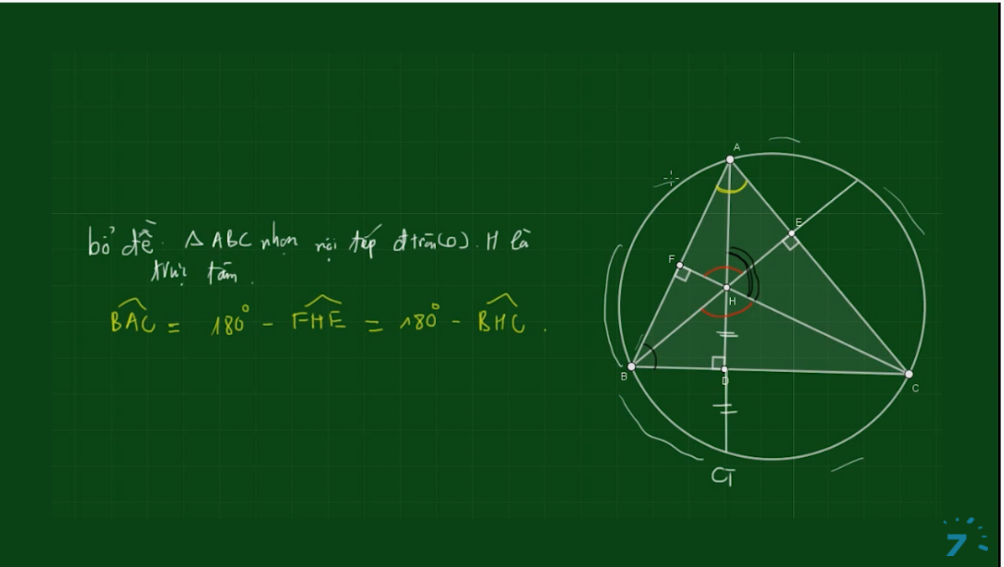
Bai 54 De Cuong – Kinh dien tam giac nhon 1 (xem trong thu muc Tu Giac Noi Tiep)

Slide 40
